Slide 1




Incident Response for Cheapz
A “quick” journey through incident response in the open source world...

Slide 2

A little about me
British but starting to feel more and more like a Dane...
Yeah yeah, one day I will speak Danish to you all...
Lived in Denmark 4.5 years, with my wife and 2 kids..
Incident Response Lead/SOC Lead/SOC Architect/CTI/Whatever else is needed…
I love open source security solutions, I run the Security Distractions blog…
I also maintain ElastiMISPStash alongside Dennis Lund Christiensen…

Slide 3
Introduction
Tonight we will talk about the following stuff:-
Theory – Kill Chain, Courses of action, NIST IR model…
Tools – MISP, ELK stack, ElastAlert, The Hive, elastimispstash…

Slide 4
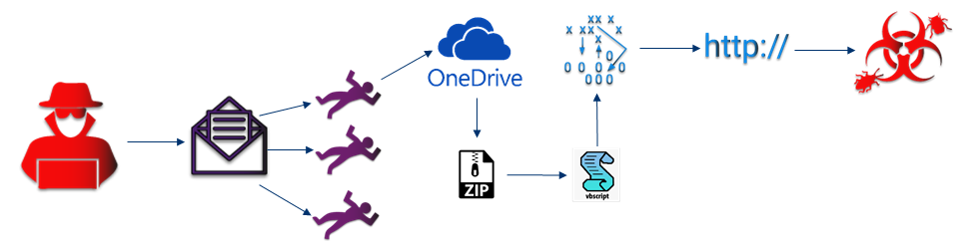
Example - Qbot early stages
A user recieves a mail reply as part of a previous mail correspondance with a friend. The new reply has a OneDrive link inside, they click on the link which retrieves a ZIP file to their machine. They unzip the file and it contains a file with a double extension, helpguide.docx.vbs. The file is shown by Windows to be a docx, so the user opens the file.

Slide 5
Example – Qbot early stages
The file was actually a VBS script, which when executed retrieved some information from WMI about the OS version, AV engine etc. It then attempted to retrieve, via BITS, second stage malware from 3 different domains, which all failed due to intelligence in the proxy filter.

Slide 6
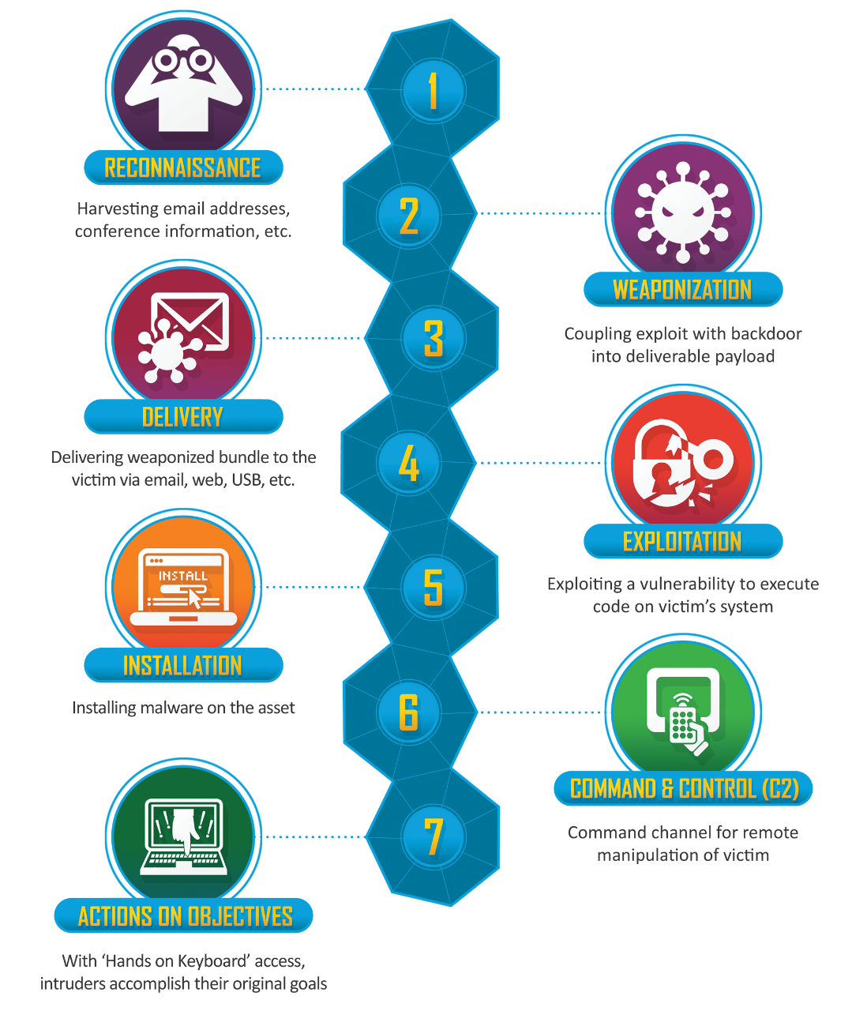
Kill Chain mapping
Recon – Previous user mail compromise
Weaponization – Email
Delivery – Spearphishing link: onedrive.com/file/1234
Exploitation – User
Installation – Execution of docx.vbs: helpguide.docx.vbs
C2 – VBS (WMI, BITS): domain1.com, domain2.com, domain3.com
Actions on objectives – Retrieve second stage malware: Hash

Slide 7
So whats next??

Slide 8
Courses of action
Discover – You gained an indicator, go search your logs for history of it
Detect – You gained an indicator, lets write a detection rule
Deny – Creating a firewall block rule, proxy filter, AV hash filter etc
Disrupt – Makes the event fail as it is occuring, example could be IPS
Degrade – Slow down the intrusion in progress, could be via bandwith throttling

Slide 9
Courses of action – Continued
Decieve – Make the intruder think the attack is successful, forwarding traffic towards a honeypot
Destroy – Offensive action against the intruder, arrest, physical destruction of property, hacking back (don’t do this)….!

Slide 10
Combining coa and cyber kill chain
 | Discover | Detect | Deny
Reconnaissance | - | - | -
Weaponization | - | - | -
Delivery (onedrive.com/file/1234) | Mail gateway logs, proxy logs | Mail gateway logs, proxy logs | Mail gateway
Exploitation (User - Spearphishing) | - | - | User awareness
Installation (helpguide.docx.vbs) | Host logs | AV alerts, host logs | AV (hash of docx)
C2 (domains) | Host logs, Proxy logs | Host logs, Intelligence alerts | Proxy filter, DNS Sinkholing
Actions on objectives (2nd stage) | Proxy logs (domains) | AV alerts, host logs (hash) | AV (hash)

Slide 11
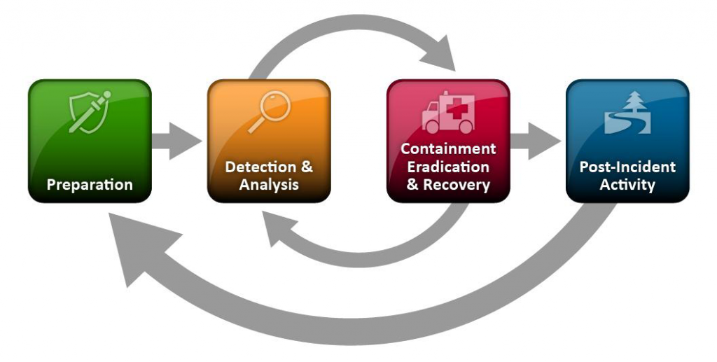
NIST IR Lifecycle/model/framework/whatever...
https://nvlpubs.nist.gov/nistpubs/SpecialPublications/NIST.SP.800-61r2.pdf

Slide 12
Discover and preparation
 | Discover
Reconnaissance | -
Weaponization | -
Delivery (onedrive.com/file/1234) | Mail gateway logs, proxy logs
Exploitation (User - Spearphishing) | -
Installation (helpguide.docx.vbs) | Host logs
C2 (domains) | Host logs, Proxy logs
Actions on objectives (2nd stage) | Proxy logs (domains)
We’re probably going to need some logs……..

Slide 13
Logging logging logging
Storage
Ship
Normalize
Enrich
Transport
Query/Visualize
Log Sources
Detection
Schema

Slide 14
ElK Stack
Made up of the following components:-
Filebeat – Log shipper
Logstash – Parsing logs, transforming and transporting them
Elasticsearch – Indexing and storing of data
Kibana – Displaying data from Elasticsearch and querying it
Indexes on ingestion (sales sales sales)

Slide 15
ElasticSearch
Storage
Filebeat
Logstash
Kibana
Ship
Normalize
Enrich
Transport
Query/Visualize
Log Sources
Detection
Schema

Slide 16
Detect and detection
 | Detect
Reconnaissance | -
Weaponization | -
Delivery (onedrive.com/file/1234) | Mail gateway logs, proxy logs
Exploitation (User - Spearphishing) | -
Installation (helpguide.docx.vbs) | AV alerts, host logs
C2 (domains) | Host logs, Intelligence alerts
Actions on objectives (2nd stage) | AV alerts, host logs (hash)
We’re definitely going to need some logs……..
Intelligence sharing…

Slide 17
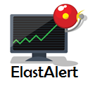
Elastalert
Developed by YELP…
Utilizes Elastic search API…
Built in Python…
Rules are built in YAML…
Modular rule design…
Monitor, Pattern, Alerter...
{
name: MISP-Alerter type: any index: sd-* filter: - query: query_string: query: "misp.tags: Feed-Alert"
alert: hivealerter” }

Slide 18
ELAstalert – Even more goodness
Plenty of Rule types
Any, Blacklist, Whitelist, Spike, etc etc
Alerters
Slack, MS Teams, The Hive, HTTP POST, etc etc
Sigma rule translator...
https://github.com/Neo23x0/sigma/blob/master/contrib/sigma2elastalert.py

Slide 19
Deny and Containment
 | Deny
Reconnaissance | -
Weaponization | -
Delivery (onedrive.com/file/1234) | Mail gateway
Exploitation (User - Spearphishing) | User awareness
Installation (helpguide.docx.vbs) | AV (hash of docx)
C2 (domains) | Proxy filter, DNS Sinkholing
Actions on objectives (2nd stage) | AV (hash)
Security tools
Proxy, DNS sinkholing, AV
User Awareness

Slide 20
MISP – Malware information sharing platform
Threat Intelligence Sharing Platform
Not just threat data!!
Developed by CIRCL in Luxembourg
Originally a NATO project…
MISP API
Used for automating lots of interesting things…

Slide 21
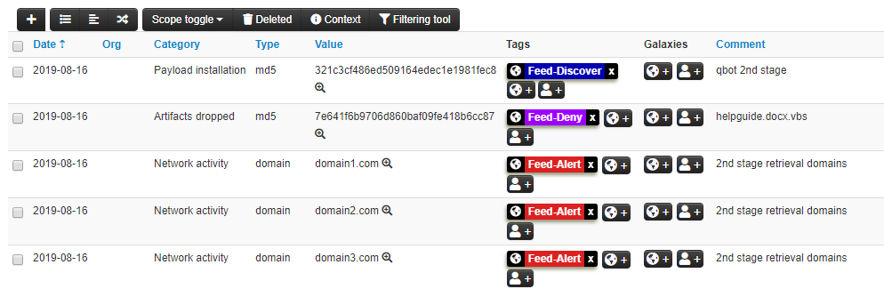
MISP - Example

Slide 22



MISP – Courses of action...
Feed-Discover
Go and out find this indicator in the entire log estate...
Feed-Alert (Detect)
Feed-Deny
API
Discover
Deny
Detect

Slide 23
Elastimispstash
Some great security guys have written an integration between ELK and MISP...
Enrichment on ingestion in real time...
Highly scalable...
Currently has support for ECS field types:-
Domain, ip and sha256

Slide 24
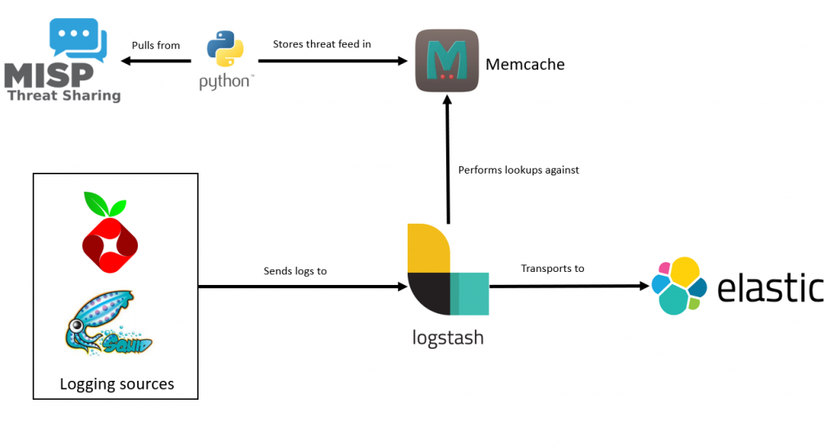
Elastimispstash

Slide 25
What do we need next time?
New indicators = New detections
Does my current awareness training work?
Do my security tools work?
Do I have the correct logs?
Is my log retention good enough?
Am I receiving good intel?

Slide 26
Whoa whoa wait... One last thing... Where do the alerts go??

Slide 27
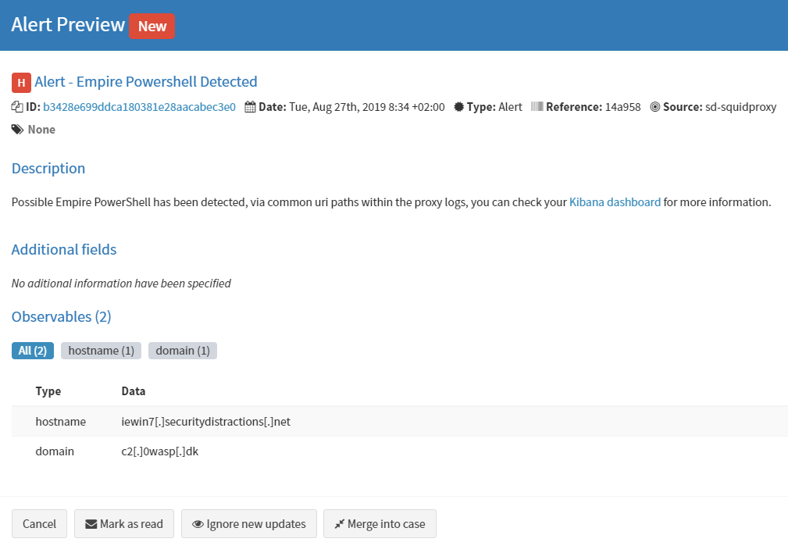

Slide 28
The Hive
Incident response case management tool...
Works with the concept of ”alerts” and ”cases” and ”observables”.
Observables (indicators) can be correlated based on:-
Previous cases…
Incoming alerts…
You can map your playbooks in as case templates…

Slide 29
Demo – APT Perto on the loose

